Slide 1

MOTSHEKA.coin

Slide 2
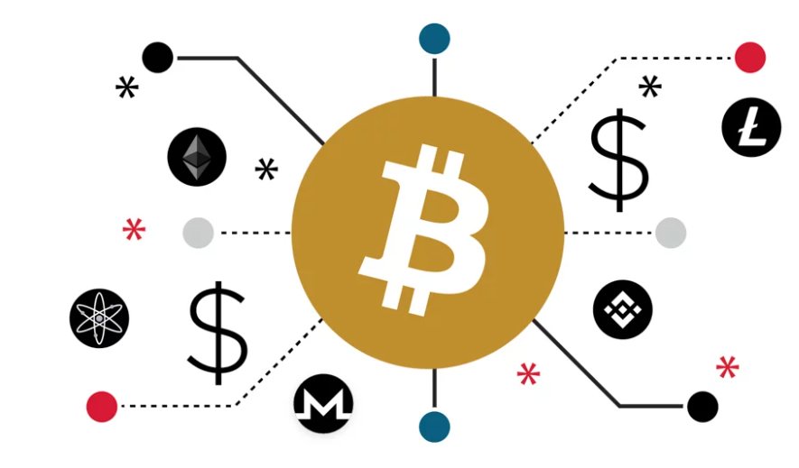
Overview
MoketjeCoin is a digital platform where users, people who are banking with African bank will have the ability to transfer their money instantaneously and more efficient. The payment method uses crypto currency as a form of asset tokenisation to spend and send money rather than traditional banking systems of using online money.

Slide 3
Why asset tokenisation?
Block chain makes international money transfers faster and less expensive helping fellow Africans who depend on interactional transfers.
Access to global Markets allowing Tokenization to provide African investors with access a range of global investment opportunities.
Tokenization enables financial inclusion and larger transactions in the absence of traditional banking.
Block chain promotes transparency reducing armours fraud, by mitigating cyber-crime as a global issue.

Slide 4
Stakeholders
Target Audience
African bank
Takealot
Entrepreneurs :Access to capital for operations and acquiring new assets.
Liquidity: Tokenization of assets can increase the liquidity allowing traders to purchase and sell pieces of assets more easily..
Property 24
Employees:Equity:Tokens can be given to reflect ownership Proving business success(e.g, Intellectual property, real estate)
SARS

Slide 5
Decentralised App
Users will be able to convert their currency into tokens called Payment tokens, a representation of a certain asset or utility.
Peer-to-peer asset tokenization allows consumers use their tokens to fraction ownership of agricultural, commercial and other business assets (e.g; partnering with reputable solar panel manufactures and distributors to ensure investment in building a robust ecosystem around the token).
By registering for this free service, taxpayers and businesses can securely and seamlessly engage with SARS by submitting returns, declarations, payments, and other actions online to invest it in crypto currency.
Users can use tokens to buy goods and services which will add value to the product or service.

Slide 6
Consideration
Uniqueness: Each token differs from another token of the same type and has unique information and attributes.
Responsible Sourcing: Promote the responsible sourcing and production of assets such as commodities, minerals or agricultural products.
Secure Wallets: Educate customers about the importance of secure wallets for storing their digital tokens. This will help accounts holder on how to protected their accounts.
Smart contracts: create ways to protect accounts if the keys are lost or stolen, providing opportunities for better fraud detection and defence.

Slide 7
Benefits
Explains the concept of smart contracts, which can automate various aspects of property ownership and trading.
Sustainable assets may have lower short-term returns than conventional investments, but can provide more stable and sustainable returns over time.
the tokenization of assets that have a positive social impact, such as affordable housing, renewable energy projects, or sustainable agriculture.
Each token differs from another token of the same type and has unique information and attributes.
Smart Contracts
Social Investment
Social Responsible
Unique

Slide 8
Benefits
Customers should be educated on blockchain, decentralized systems, and tokenization, with a focus on transparency, security, and efficiency.
Develop interfaces that promote the best customer experience for customers to interact with the decentralized system.
Tokenization is the process of converting physical goods into digital assets on a blockchain.
Secure wallets are critical for safeguarding digital tokens.
Consumer Education
User-Friendly Interfaces
Simplify Tokenization
Secure Wallets

Slide 9
Back End
handling sensitive financial information and ensuring the security of digital assets
Implement secure coding practices to protect against common vulnerabilities
tools for users to recover their accounts in case of loss by upgrading EOAs
Implement robust backup and disaster recovery plans to ensure data integrity and availability.
Front end
secure web hosting platform
Ensure that the design is user-friendly, responsive, and visually appealing.
Implement secure key storage using technologies like localStorage, sessionStorage
Database
Blockchain stores databases on all nodes of the network in a ledger platform
ganache is ideal for local instead of network development and testing
Development Strategy

Slide 10
Reporting
Environmental, Social, and Governance (ESG) reporting is a critical aspect of corporate responsibility and sustainability.
Web 3.0 technologies become more widely used in ESG reporting as a process that organisations are exploring to increase the precision, transparency, and efficiency of reporting.
To ensure transparency, compliance, and trust in the tokenized asset ecosystem, reporting and auditing are essential.

